Slide 1
Sexual Health Week 2021 Consent
Notes:
Starting Slide.
You may also use this slide to set your boundaries/expectation and give a disclaimer for those in your assembly/class/group/lesson/registration/tutor period.

Slide 2
Do you ask for it? Do you get asked for it? Do you know what it means? Do you know when to get it? Do you know how to get it? Do you expect it?
Imagery source: Brook Sexual Health Week
Notes:
Sexual Health week happens in early September every year. This year the focus is on consent.
(Imagery source: Brook Sexual Health Week)

Slide 3
Dictionary Definition
Permission for something to happen or agreement to do something
Notes:
Consent covers a wide variety of situations and it starts with a conversation.
Consent and communication are tightly linked together.
They can have a large impact on our relationships, be it with friends, family or a partner (sexual or not)

Slide 4
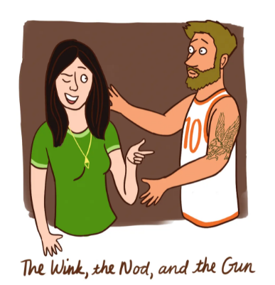
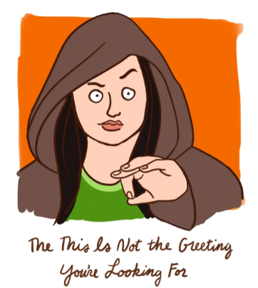
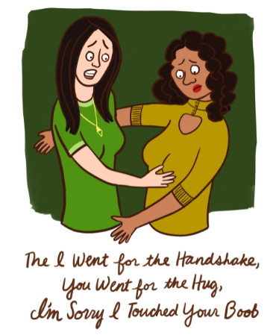
We navigate consent all the time
Sometimes we get it right, sometimes we don’t.
Take hugs……
Are you a hugger?
Are your friends or family huggers?
How do you know if someone else is a hugger?
When do you hug, when do you shake hands?
How do you let people know if you’re not a hugger?
Illustration by Emily Niland
Notes:
Illustration by Emily Niland
We navigate consent all the time in life, sometimes we get it right and other times we don’t.
Take hugs.
While in certain social situations you know you wouldn’t usually hug someone e.g. At the end of your first day at work you’re not likely to hug your boss.
In other situations it’s harder to know; a new friendship, when you meet a friends girlfriend, boyfriend or partner.
Some people love to hug in many situations others would prefer not to hug at all.
It’s not always easy to tell?
Some people will tell you before hand or after the event.
Sometimes you will pick up on someone's body language to give you an idea. Open arms walking towards you, oh that’s a hugger. Someone looking hesitant as you approach for a hug or taking a step back, or freezing or limiting their physical contact with you while in a hug, probably not a hugger.
If we get a hugging situation wrong, it’s often quickly corrected for the next time and usually not too much embarrassment or damage happens. We certainly don’t need to worry about the law.
You can always get ahead of the situation by asking is someone is a hugger or not before you hug. If you’re not sure it’s better not to.

Slide 5
Consent Definition
Someone consents to vaginal, anal or oral penetration only if s/he/they agrees by choice to that penetration and has the FREEDOM and CAPACITY to make that choice.
Consent to sexual activity may be given to one sort of sexual activity but not another.
Consent can be WITHDRAWN AT ANY TIME during sexual activity and each time activity occurs.
www.plannedparenthood.org
Notes:
Consent in relation to sexual activity is actually defined in law: Section 74 of the Sexual Offence Act 2003.
Someone consents to vaginal, anal or oral penetration only if s/he/they agrees by choice to that penetration and has the freedom and capacity to make that choice.
Consent to sexual activity may be given to one sort of sexual activity but not another, e.g. to oral sex but not anal, nipple play but not vulva rubbing. Or consent by be given to penetration but with conditions, such as wearing a condom.
Consent can be withdrawn at any time during sexual activity and each time activity occurs. This means getting consent in writing or as a video statement of agreement isn’t effective, as it’s only valid for that particular moment. People can change their mind, or not enjoy something they though they would and want to stop.
If your young people haven’t seen the Tea consent video – now is a good time to show it. - see link below it lasts for 2.49.
https://www.youtube.com/watch?v=fGoWLWS4-kU

Slide 6
Consent: The Law
Age of legal consent is 16.
Under 13’s cannot give any form of sexual consent.
You can’t consent if you are drunk or high on drugs.
Asking for, creating, distributing and possessing nudes of someone under 18 is illegal. By law you need to be over 18 to send nudes. Sending nudes as an adults can have personal consequences. You must get consent before you press send. Not everyone wants a visual’
Everyone is legally protected from sexual harassment by law.
Notes:
The legal age of consent for any gender or sexual identity is 16 in the UK.
No matter your age, if you are drunk or high on drugs you cannot consent to sexual activity. Being drunk or high is not determined by the amount you have consumed because everyone is different.
Nudes have different laws depending on your age, but consequences are still there even after the age of 18. This is as much about e safety as it is sex and relationships and the law. It can have a far reaching impact on your life in many ways. You can be prosecuted for revenge porn in the UK. Everyone is legally protected from sexual harassment by law.

Slide 7
Sexual Activity: What yes looks like
Keep doing that
YES!
Being an active body
Don’t Stop
Notes:
A “yes”, can come in many forms, but you are looking for a positive, enthusiastic yes.
You can look out for it physically too (an active body – not everyone is able to communicate verbally)
If a yes doesn’t sound very sure, stop and check again.
If someone says yes but they aren’t physically active towards you, stop and check, it might be a no or not sure or maybe that have change their mind or are uncomfortable.
Give you partner the chance to think, say no.
You can reassure them it’s ok if they want to stop.
You should expect the same.

Slide 8
Sexual Activity: What no looks like
I wanted to but now…
maybe
Not saying anything or
just lying there
Keeping direct eye contact
Notes:
A person might sound unsure (maybe)
They might be making eye contact with you hoping you might realise they don’t like or want this act.
Equally they might avoid eye contact and be feeling the same way.
You’re not a mind reader, so ask and check in as you go along.
They might have said yes verbally but they might not be responding much physically or at all. If you aren’t sure stop and check.
Some people are able to speak up for themselves other people stop talking in situations when they are under confident, unsure, confused, unhappy or nervous. Stop and check, give your partner the chance to communicate what they want and don’t want.

Slide 9
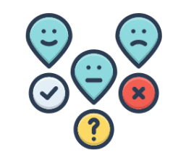
Sexual Activity: What no looks like
No
I like you
ummm
Saying yes to other sexual contact or acts
Notes:
No can be said verbally, but it might not be as straight forward as the word no.
You need to look for physical signs too, such as a silent, or inactive body.
It might be something clearer like being push away.
They might may a positive statement such as “I like you” but it doesn't mean they like what your are doing.
You can stop and check. A simple I like you too, are you ok with this? Do you want me to keep going?
It’s worth remembering someone might like one sexual act but not be happy with another.
Keep asking and checking as you go even if you’ve discussed acts in advance or have done them before.

Slide 10
Everyday Consent
Deciding which film to watch
How you address someone verbally (pronouns, nick names etc.)
How you greet someone physically
Who has access to your social media
Ordering a take away meal
Notes:
We navigate consent every day. Usually through conversation and body language.
Discussing what we want and don’t want, our likes and dislikes.
Where there is room for compromise and where there is not.
What is ok in a situation and what is not.
Some of us are confident about expressing our desires and boundaries and some of us less so.

Slide 11
Setting and Holding Boundaries
Clip from the BBC https://www.youtube.com/watch?v=Xaq4nN2QwEI
Notes:
Let’s watch this clip from Gavin and Stacey. They are ordering a take away.
Observe and how different peoples choices and preferences are voiced.
Video is embedded click to activate. Video length 1.42.
https://www.youtube.com/watch?v=Xaq4nN2QwEI
Smithy is clearly very comfortable in this situation and the people he is with.
There is no imbalance of power in this situation. He doesn’t have any undue influence or pressure being put on his choice even though other opinions are discussed.
While Smithy might be very boisterous and forthright in his boundaries everyone is clear where he stands.
Smithy clearly has CAPACITY and FREEDOM to communicate his boundaries and choices.
He has mental capacity, he doesn’t have anything impinging on his capacity.
The relationships here are healthy ones.
While you might not need to raise you voice the way smithy does, he is very clear and specific about his expectation and boundaries.
We need to be clear in our relationships about our desires and our boundaries.

Slide 12
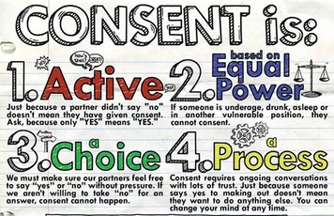
https://www.haven-oakland.org/
Notes:
When it comes to sexual activity we need to ensure consent is: active, equal, a choice and an ongoing process.
Active: We have already visited what YES and No can look and sound like.
Equal Power: Consent cannot be given if a person is in a vulnerable position: drunk, high, asleep, unconscious, or if they don’t have mental capacity.
Choice: You or your partner must feel free to say “yes” or “no” without any pressure. Conversations are good, but nagging, demanding or trying to convince someone is not appropriate.
A process: It requires an ongoing conversation and checking in with someone. Consent is reversible at any point. You or they are allowed to change their mind.

Slide 13
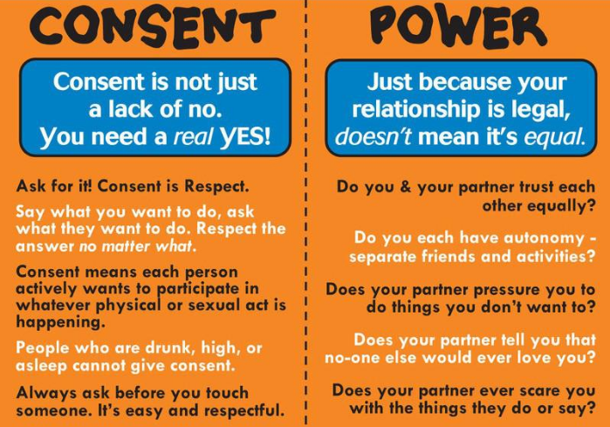
goodconsentguide.co.uk
Devon and Cornwall police
https://www.reddit.com/r/coolguides/comments/ns577f/consent_and_power/
Notes:
No matter your age if there is a power imbalance in the relationship you are not able to give consent because your freedom and capacity may be reduced or affected.
You need to be in a healthy and safe relationship to be able to give consent.

Slide 14
How and when to ask for consent?
It’s best to have open communication. Talk about your likes and dislikes what you want, would like to try or don’t want.
Talk about sexual activity before and after the event.
If you’re shy sometimes not talking face to face but side by side is easier.
Check in with your partner while you are intimate.
Listen and watch your partner attentively when you are intimate to look for non verbal clues too.
Notes:
Open communication is great for any relationship, it’s particularly important for sexual relationships.
It helps avoid boundaries being broken and can lead to a more pleasurable and enjoyable experience too.
Communication needs to be open, honest and ongoing.

Slide 15
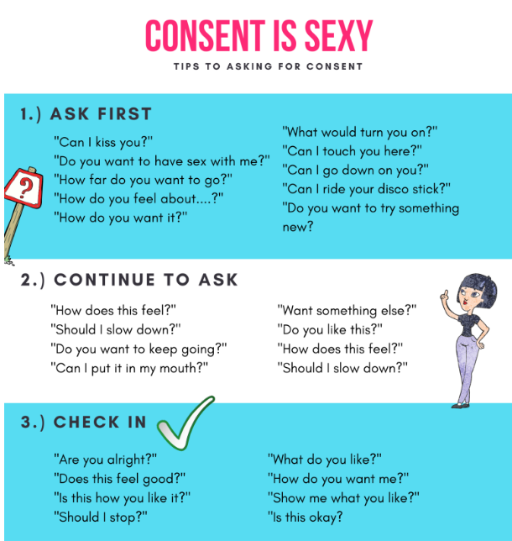
Tip for asking for consent
The Shrew at https://eryncarter.com/
Notes:
Sometimes it can be hard to find the words, so we have some tips for you.
Select a few from the slide to read out.

Slide 16
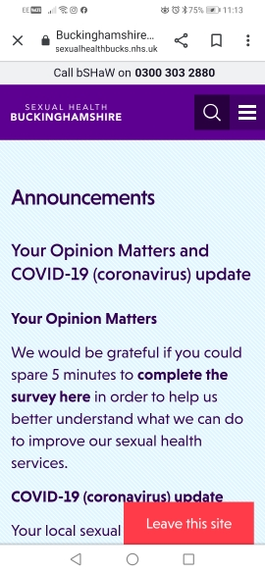
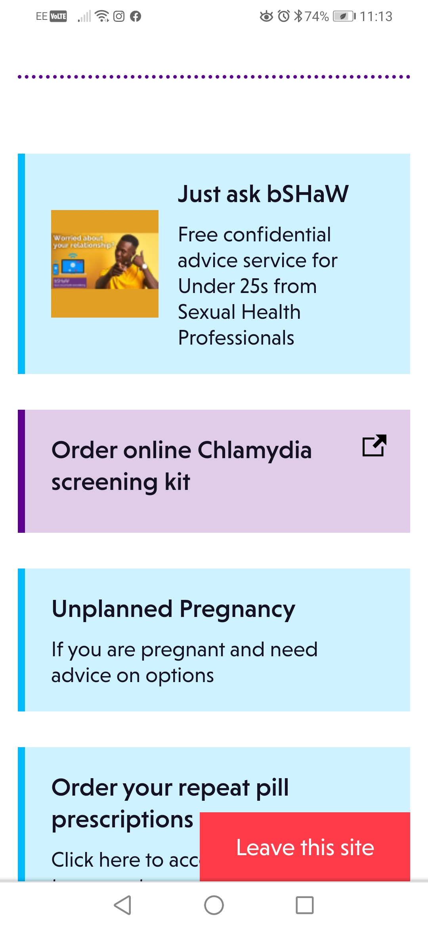
Need more help?
bSHaW website is for you
Google Sexual Health Bucks
Look for Just Ask bSHaW
Request a call back
We check it’s a good time to talk.
You can talk to a sexual health professional about consent, relationships and sexual health.
Notes:
Did you know that bSHaW (Buckinghamshire Sexual Health and Wellbeing) has a dedicated service where you can request a call back to talk to a sexual health professional. They check it’s a good time to talk at the start. Google Sexual Health Bucks, we are also on Facebook and Instagram.
We can talk about sex and relationships and consent.
We can also provide sign posting to sexual health services.
We can also provide free postal condoms via the c card scheme (open to 13-24 year olds)

Slide 17
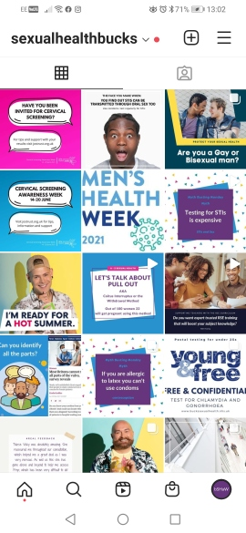
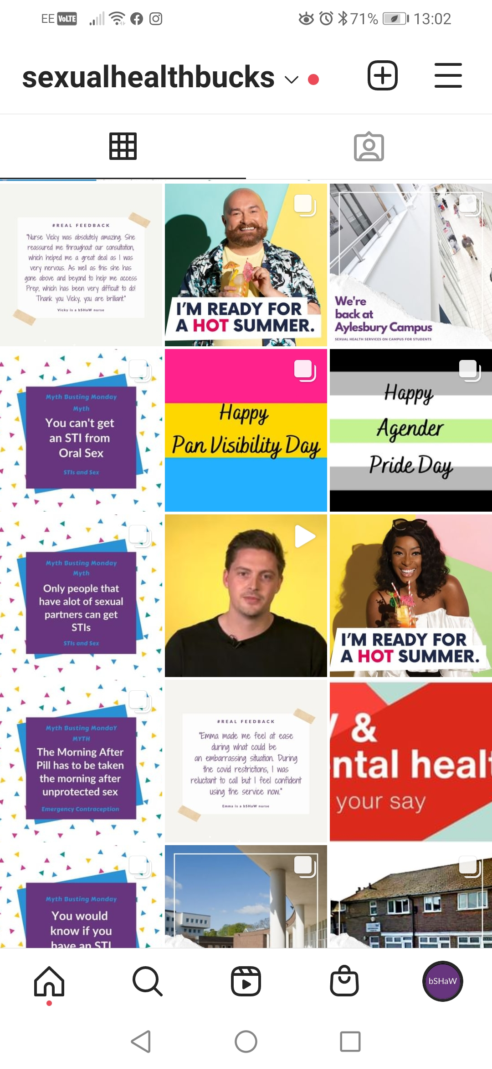
Need more help?
Sexual Health Bucks
We will have consent content during sexual health week
We have great safe, accurate and reliable content about sexual health and relationships
It connects to our website for easy access to services
Check out Sexual Health Bucks on Instagram and Facebook
Notes:
Check out Sexual Health Bucks on Instagram and Facebook, we’ll be posting all about consent.
We have great, sexual health and relationships content that is safe and accurate.

Slide 18
Need more help?
Notes:
The Mix and LGBT Foundation have helplines to discuss any issues around sexual health too.
Brook have a range of information on consent. All are on social media as well as the internet.
Sexual health week 2021 is focussing on consent so you can find a lot of content online right now.

Slide 19
Take Away Points
Communicate with your partner
Consent is an ongoing process
Freedom and capacity are a requirement
Help and support can be found online, on the phone and on social media
Notes:
It might also be worth mentioning help points in your establishment Student welfare/school nurse/ student services / DSL etc.

